Slide 1

Data and Process Modeling
Software Engineering
Fall 2021

Slide 2
Lecture Objectives
Describe data and process modeling concepts and tools, including data flow diagrams, a data dictionary, and process descriptions
Describe the symbols used in data flow
diagrams and explain the rules for their use
Draw data flow diagrams in a sequence, from general to specific
Explain how to level and balance a set of data flow diagrams

Slide 3
Lecture Objectives
Describe how a data dictionary is used and
what it contains
Use process description tools, including structured English, decision tables, and decision trees
Describe the relationship between logical and physical models

Slide 4
Data and Process Modeling
Data and Process Modeling is a way of developing a graphical model that shows how a system converts data into valuable information. The result of such modeling is a logical model that provides support for business operations and ensures that user's needs are fulfilled.

Slide 5
Data Model
A data model is a description of how data should be used to meet the requirements given by the end user.
Data modeling helps to understand the information requirements. Data modeling differs according to the type of the business, because the business processes or each sector is different, and it needs to be identified in the modeling stage. Initial step is the analyzing the situation, gather data.
Data modeling process starts with requirement gatherings. When developing the proper data model it is important to communicate with the stakeholders about the requirements.
Data modeling is the act of exploring data oriented structures. This can be used for variety of purposes.
One of the important functions of data modeling is that, it helps to understand the information requirements. Especially this makes both developers and end users lives easier. As mentioned above, data modeling helps the end users to define their requirements, and the developers are able to develop a system to meet those specified requirements.

Slide 6
Introduction
A logical model of the proposed system and document the system requirements
Logical model shows what the system must do
Physical model describes how the system will be
Constructed.

Slide 7
Logical and Physical Model
The logical model and the physical model are separate models.
The logical model enables you to represent business information and define business rules.
The physical model enables you to focus on the physical implementation of the model in a database.
Both the logical and physical models represent design layers in the application development process.

Slide 8
Overview of Data and Process
Modeling Tools
Systems analysts use many graphical
techniques to describe an information system
A data flow diagram (DFD) uses various symbols to show how the system transforms input data into useful information

Slide 9
Data Flow Diagrams (DFDs)

Slide 10

Data Flow Diagrams
A data flow diagram (DFD) shows how data moves through an information system but does not show program logic or processing steps
A set of DFDs provides a logical model that shows what the system does, not how it does it

Slide 11
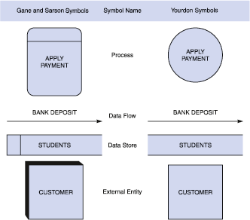
Data Flow Diagrams
DFD Symbols

Slide 12
Elements of DFDs
All data flow diagrams include four main elements: entity, process, data store and data flow.

Slide 13
External Entity
Also known as actors, sources or sinks, and terminators, external entities produce and consume data that flows between the entity and the system being diagrammed. These data flows are the inputs and outputs of the DFD. Since they are external to the system being analyzed, these entities are typically placed at the boundaries of the diagram. They can represent another system or indicate a subsystem.

Slide 14
Process
An activity that changes or transforms data flows. Since they transform incoming data to outgoing data, all processes must have inputs and outputs on a DFD. This symbol is given a simple name based on its function, such as “Ship Order,” rather than being labeled “process” on a diagram. In Gane-Sarson notation, a rectangular box is used and may be labeled with a reference number, location of where in the system the process occurs and a short title that describes its function. Processes are typically oriented from top to bottom and left to right on a data flow diagram.

Slide 15
Data Store
A data store does not generate any operations but simply holds data for later access. Data stores could consist of files held long term or a batch of documents stored briefly while they wait to be processed. Input flows to a data store include information or operations that change the stored data. Output flows would be data retrieved from the store.

Slide 16
Data Flow
Movement of data between external entities, processes and data stores is represented with an arrow symbol, which indicates the direction of flow. This data could be electronic, written or verbal. Input and output data flows are labeled based on the type of data or its associated process or data store, and this name is written alongside the arrow.

Slide 17
Valid DFDs Rules
Before you start mapping out data flow diagrams you need to follow four best practices to create a valid DFD.
Each process should have at least one input and one output.
Each data store should have at least one data flow in and data flow out.
A system’s stored data must go through a process.
All processes in a DFD must link to another process or data store.

Slide 18
Data Flow Diagrams
DFD Symbols
Process symbol
Receives input data and produces output that has a different content, form, or both
Contain the business logic, also called business rules
Referred to as a black box

Slide 19
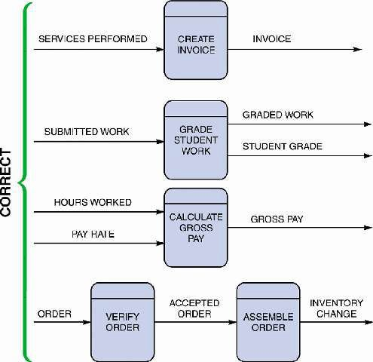
Data Flow Diagrams
DFD Symbols
Data flow symbol
Represents one or more data items
The symbol for a data flow is a line with a single or double arrowhead
Spontaneous
generation
Black hole
Gray hole

Slide 20
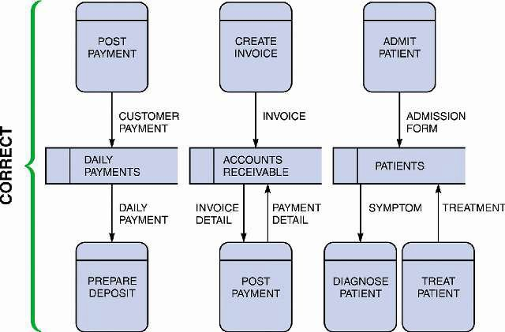
Data Flow Diagrams
DFD Symbols
Data store symbol
Represent data that the system stores
The physical characteristics of a data store are unimportant because you are concerned only with a logical model
10

Slide 21
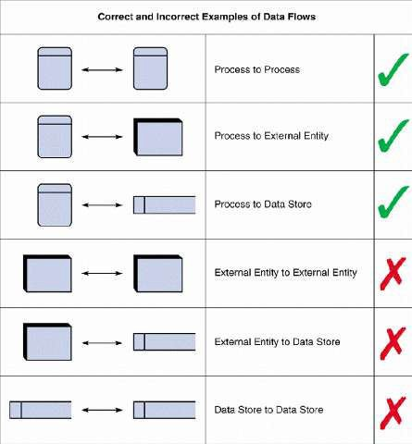
Data Flow Diagrams
DFD Symbols
Entity Symbol
Name of the entity appears inside the symbol
Terminators
Source
Sink

Slide 22
Creating a Set of DFDs
Create a graphical model of the information
system based on your fact-finding results
First, you will review a set of guidelines for drawing DFDs. Then you will learn how to apply these guidelines and create a set of DFDs using a three-step process

Slide 23
Creating a Set of DFDs
Guidelines for Drawing DFDs
Draw the context diagram so that it fits on one
page
Use the name of the information system as the
process name in the context diagram
Use unique names within each set of symbols

Slide 24
Creating a Set of DFDs
Guidelines for Drawing DFDs
Do not cross lines
Provide a unique name and reference number for each process
Obtain as much user input and feedback as
possible

Slide 25
Levels of DFDs
DFDs can range from simple overviews to complex, granular representations of a system or process with multiple levels, starting with level 0. The most common and intuitive DFDs are level 0 DFDs, also called context diagrams. They’re digestible, high-level overviews of the flow of information through a system or process, so almost anyone can understand it.

Slide 26
Level 0: Context Diagram
This DFD level focuses on high-level system processes or functions and the data sources that flow to or from them.
Level 0 diagrams are designed to be simple, straightforward overviews of a process or system.

Slide 27
Level 1: Process Decomposition
While level 1 DFDs are still broad overviews of a system or process, they’re also more detailed — they break down the system’s single process node into subprocesses.

Slide 28
Level 2: Deeper Dives
The next level of DFDs dive even deeper into detail by breaking down each level 1 process into granular subprocesses.

Slide 29
Level 3: Increasing Complexity
Level 3 and higher-numbered DFDs are uncommon. This is largely due to the amount of detail required, which defeats its original purpose of being easy to understand.

Slide 30
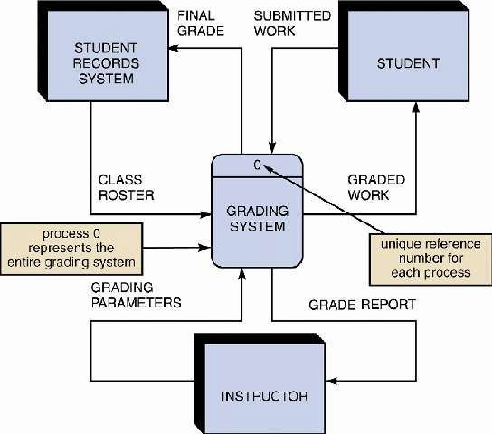
Creating a Set of DFDs
Step 1: Draw a Context Diagram

Slide 31
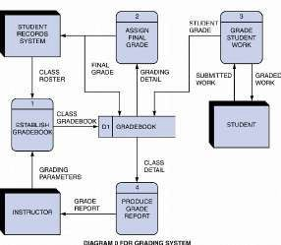
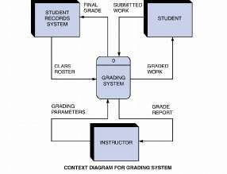
Creating a Set of DFDs
Step 2: Draw a Diagram 0 DFD

Slide 32
Creating a Set of DFDs
Step 2: Draw a Diagram 0 DFD
If same data flows in both directions, you can use
a double-headed arrow
Diagram 0 is an exploded view of process 0
Parent diagram
Child diagram
Functional primitive

Slide 33
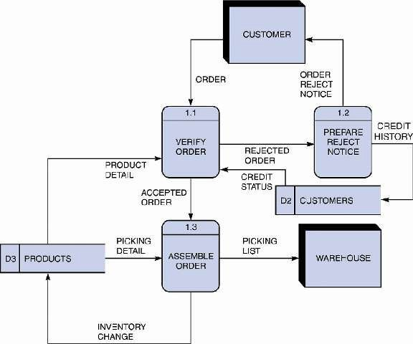
Creating a Set of DFDs
Step 3: Draw the Lower-
Level Diagrams
Must use leveling and balancing techniques
Leveling examples
Uses a series of increasingly detailed DFDs to describe an information system
Exploding, partitioning, or
decomposing

Slide 34
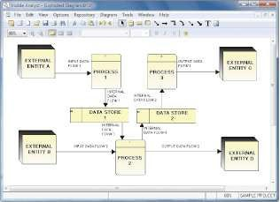
Creating a Set of DFDs
Step 3: Draw the Lower-
Level Diagrams
Balancing Examples
Ensures that the input and output data flows of the parent DFD are maintained on the child DFD

Slide 35
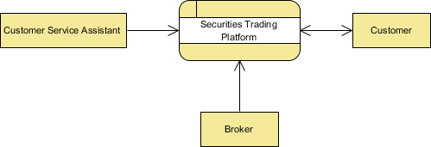
Level 0 DFD Example
This Level 0 DFD provides a contextual map of a securities trading platform. Data flows in one direction from the customer service assistant and the broker to the platform, and in two directions from customers to the platform and back again.

Slide 36
Level 1 DFD Example
This Level 1 DFD breaks down the customer process in more detail, expanding it to include account creation, cash withdrawals, and eventual securities transactions.

Slide 37
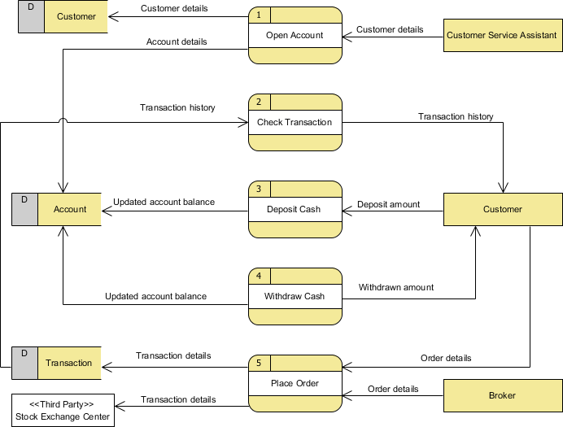

Slide 38
Level 2 DFD Example
This Level 2 DFD decomposes the “Place Order” process to contextualize the steps required to place an order — either by a customer or by a broker. It even accounts for a third-party stock exchange center where transaction details are forwarded after an order is placed.

Slide 39
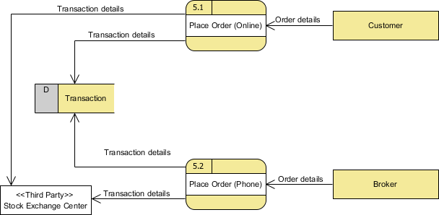

Slide 40
How to make a DFD?
Select a system or process.
Categorize related business activities.
Draw a Context DFD.
Check your work.
Create child diagrams.
Expand processes into Level 1 DFDs.
Repeat as needed.

Slide 41
Data Dictionary
A data dictionary, or data repository, is a central storehouse of information about the system’s data
An analyst uses the data dictionary to collect, document, and organize specific facts about the system
Also defines and describes all data elements and meaningful combinations of data elements
20

Slide 42
Data Dictionary
A data element, also called a data item or field, is the smallest piece of data that has meaning
Data elements are combined into records, also
called data structures
A record is a meaningful combination of related data elements that is included in a data flow or retained in a data store

Slide 43
Data Dictionary
Using CASE Tools for Documentation
The more complex the system, the more difficult it
is to maintain full and accurate documentation
Modern CASE tools simplify the task
A CASE repository ensures data consistency
You will learn more about CASE tools in Part 2 of
the Systems Analyst’s Toolkit

Slide 44
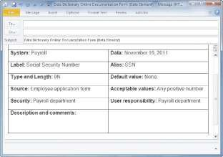
Data Dictionary
Documenting the Data
Elements
You must document every data element in the data dictionary
The objective is the same: to provide clear, comprehensive information about the
data and processes that
make up the system

Slide 45
Data Dictionary
Documenting the Data Elements
The following attributes usually are recorded and
described
Data element name and label
Alias
Type and length
Default value
Acceptable values - Domain and validity rules

Slide 46
Data Dictionary
Documenting the Data Elements
The following attributes usually are recorded and
described
Source
Security
Responsible user(s)
Description and comments

Slide 47
Data Dictionary
Documenting the Data Flows
The typical attributes are as follows
Data flow name or label
Description
Alternate name(s)
Origin
Destination
Record
Volume and frequency

Slide 48
Data Dictionary
Documenting the Data Stores
Typical characteristics of a data store are
Data store name or label
Description
Alternate name(s)
Attributes
Volume and frequency

Slide 49
Data Dictionary
Documenting the Processes
Typical characteristics of a process
Process name or label
Description
Process number
Process description

Slide 50
Data Dictionary
Documenting the Entities
Typical characteristics of an entity include
Entity name
Description
Alternate name(s)
Input data flows
Output data flows

Slide 51
Data Dictionary
Documenting the Records
Typical characteristics of a record include
Record or data structure name
Definition or description
Alternate name(s)
Attributes
30

Slide 52
Data Dictionary
Data Dictionary Reports
Many valuable reports
An alphabetized list of all data elements by name
A report describing each data element and indicating the user or department that is responsible for data entry, updating, or deletion
A report of all data flows and data stores that use a particular data element
Detailed reports showing all characteristics of data elements, records, data flows, processes, or any other selected item stored in the data dictionary

Slide 53
Process Description Tools
A process description documents the details of a functional primitive, which represents a specific set of processing steps and business logic
It should be noted that this chapter deals with structured analysis, but the process description tools also can be used in object- oriented development, which is described in Chapter 6

Slide 54
Process Description Tools
Modular Design
Based on combinations of three logical
structures, sometimes called control
structures, which serve as building blocks for the process
Sequence
Selection
Iteration - looping

Slide 55
Process Description Tools
Structured English
Must conform to the following rules
Use only the three building blocks of sequence, selection, and iteration
Use indentation for readability
Use a limited vocabulary, including standard terms used in the data dictionary and specific words that describe the processing rules

Slide 56
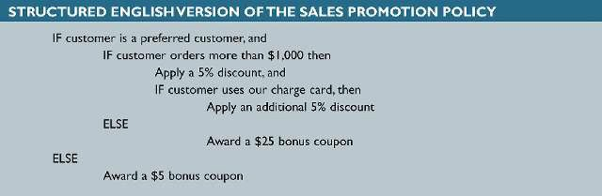
Process Description Tools
Structured English
Might look familiar to programming students
because it resembles pseudocode
The primary purpose of structured English is to
describe the underlying business logic

Slide 57

Process Description Tools
Decision Tables
Shows a logical structure, with all possible
combinations of conditions and resulting actions
It is important to consider every possible outcome
to ensure that you have overlooked nothing

Slide 58
Process Description Tools
Decision Tables
The number of rules doubles each time you add a
condition
Can have more than two possible outcomes
Often are the best way to describe a complex set
of conditions

Slide 59
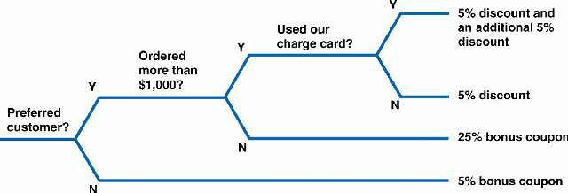
Process Description Tools
Decision Trees

Slide 60
Logical Versus Physical Models
While structured analysis tools are used to develop a logical model for a new information system, such tools also can be used to develop physical models of an information system
A physical model shows how the system’s
requirements are implemented

Slide 61
Logical Versus Physical Models
Sequence of Models
Many systems analysts create a physical model of the current system and then develop a logical model of the current system before tackling a logical model of the new system
Performing that extra step allows them to understand the current system better
40

Slide 62
Logical Versus Physical Models
Four-Model Approach
Develop a physical model of the current system, a logical model of the current system, a logical model of the new system, and a physical model of the new system
The only disadvantage of the four-model approach is the added time and cost

Slide 63
Chapter Summary
During data and process modeling, a systems analyst develops graphical models to show how the system transforms data into useful information
The end product of data and process modeling is a logical model that will support business operations and meet user needs
Data and process modeling involves three main tools: data flow diagrams, a data dictionary, and process descriptions

Slide 64
Chapter Summary
Data flow diagrams (DFDs) graphically show the movement and transformation of data in the information system
DFDs use four symbols
A set of DFDs is like a pyramid with the
context diagram at the top

Slide 65
Chapter Summary
The data dictionary is the central
documentation tool for structured analysis
Each functional primitive process is documented using structured English, decision tables, and decision trees
Structured analysis tools can be used to develop a logical model during one systems analysis phase, and a physical model during the systems design phase

Slide 66
Chapter Summary
Chapter 5 complete

